Slide 1


Beautiful Italy for... beautiful Fisec
General Assembly Fisec
Santa Margherita Ligure (Genova) ITALIA
24-27 Novembre 2016

Slide 2
Welcome FISEC friends!!
From November 24 to 27 the General Assembly FISEC 2016 will be held in Italy.
It’s a great honor and above all a great pleasure for Fisiae Italia to welcome the members of FISEC!

Slide 3
Where we will be …… the great beauty!!
We’ll stay in Santa Margherita Ligure, a beautiful splendid little town near Genova (25 km) and Portofino. It is situated directly on the suggestive sea of Liguria, one of the most beautiful regions of Italy!!

Slide 4
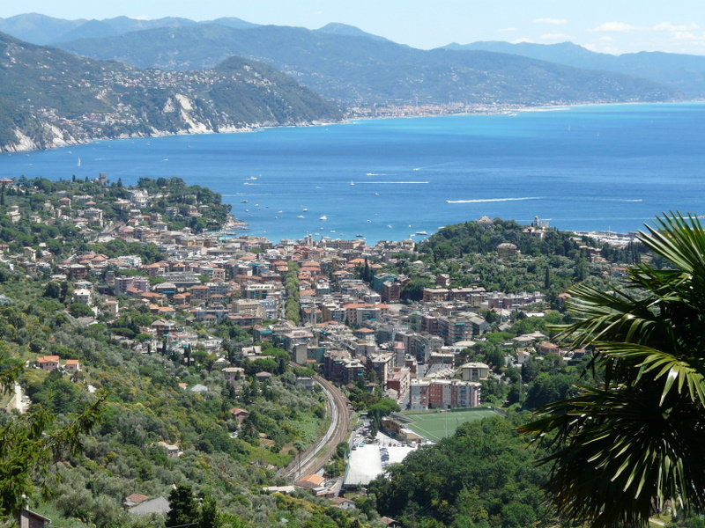
For your eyes and….. for your heart…..

Slide 5
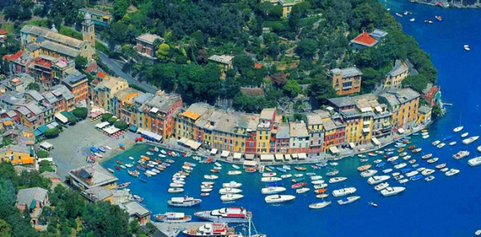
…the landscape… the italian suggestive views…

Slide 6
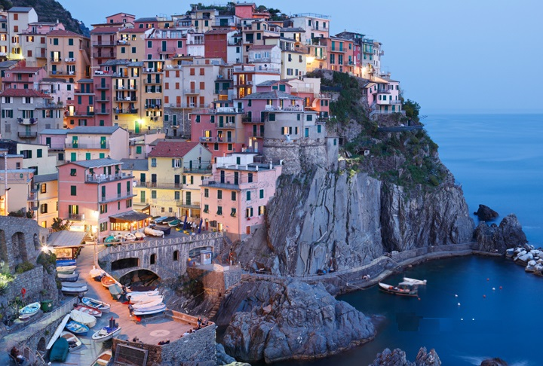
…..the lights…..the colours…. around us….

Slide 7
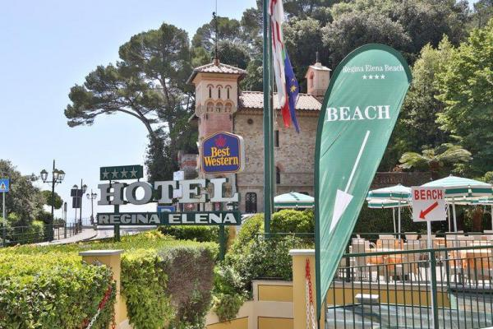
Our hotel….. and other things that will make you smile….
http://www.reginaelena.it

Slide 8
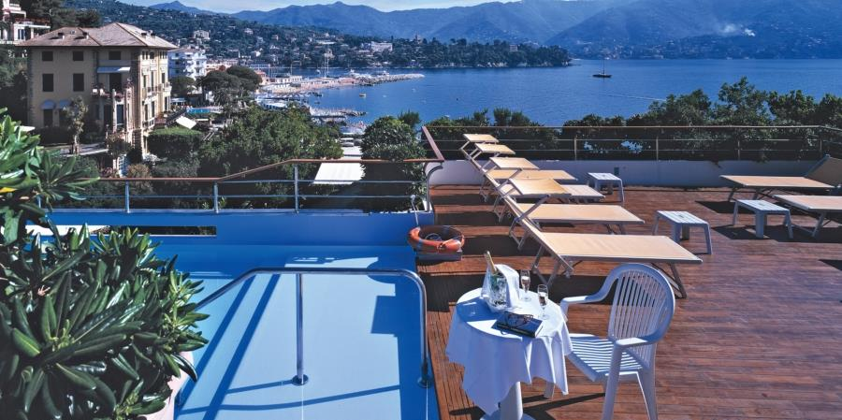
….also the eyes want satisfaction during work….

Slide 9
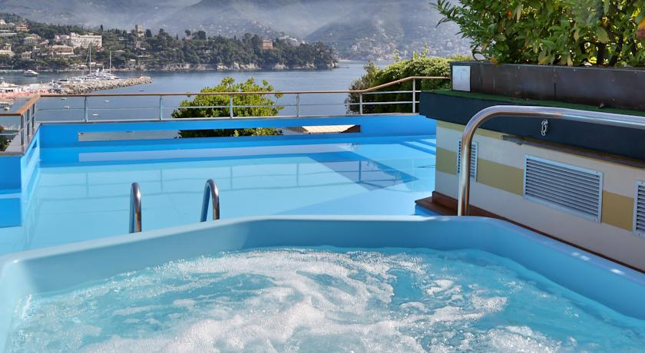
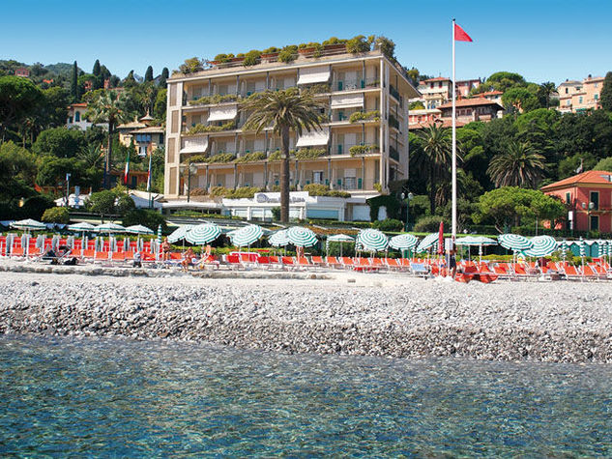
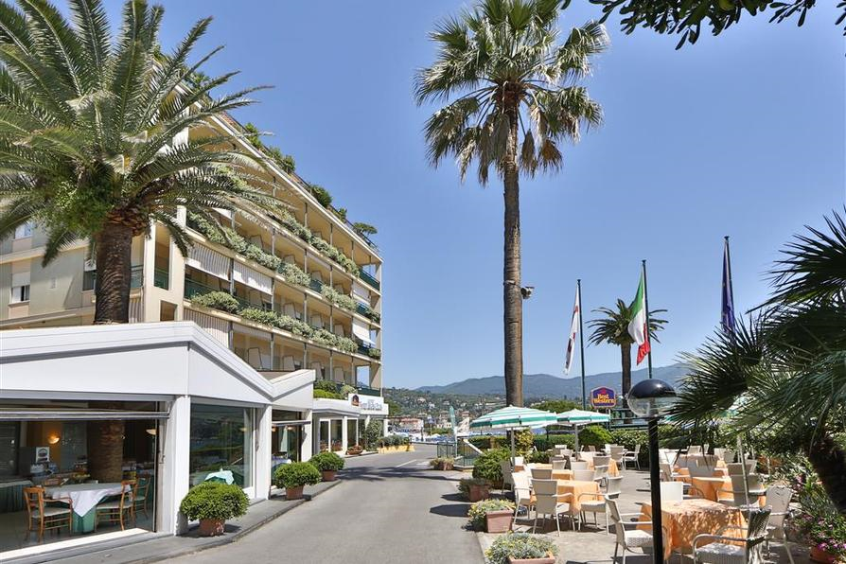
….or not…what do you think!!!

Slide 10
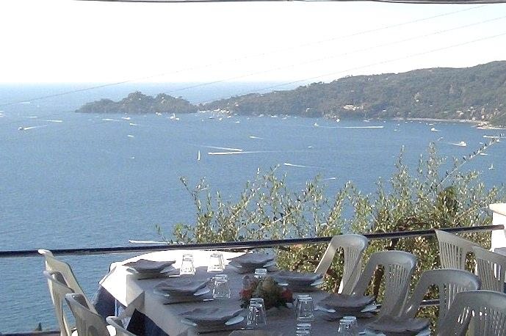
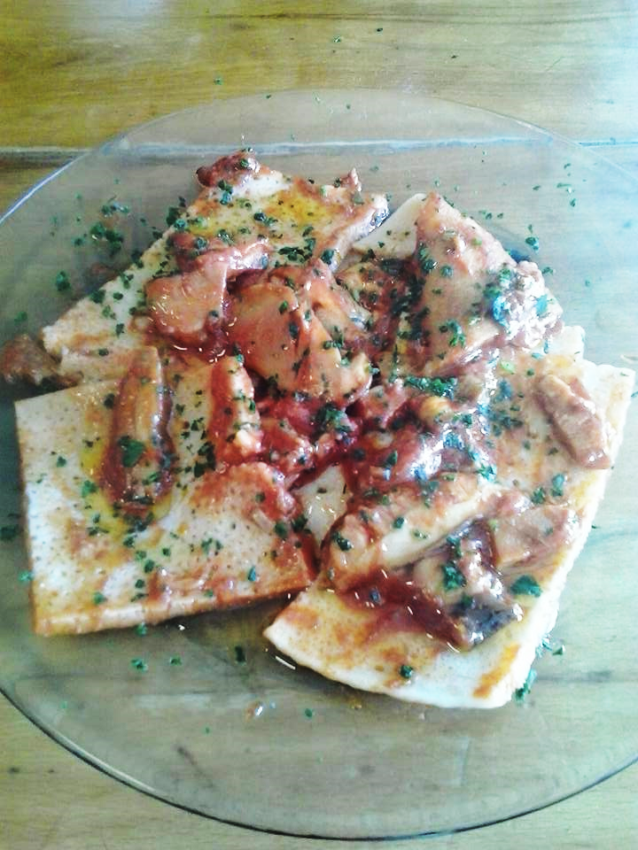
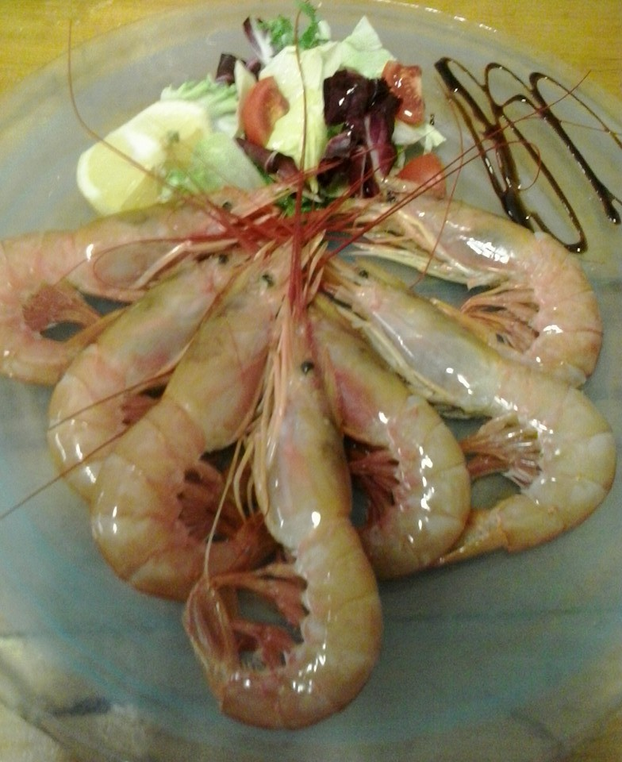
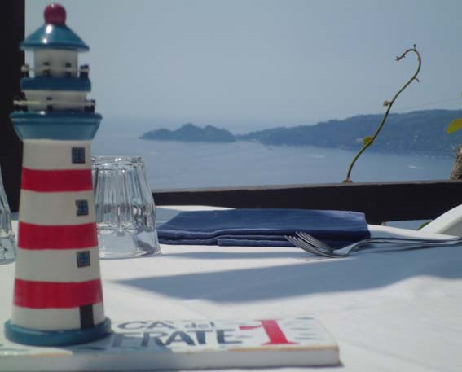
The official dinner, a joy for the eyes and the appetite…..

Slide 11
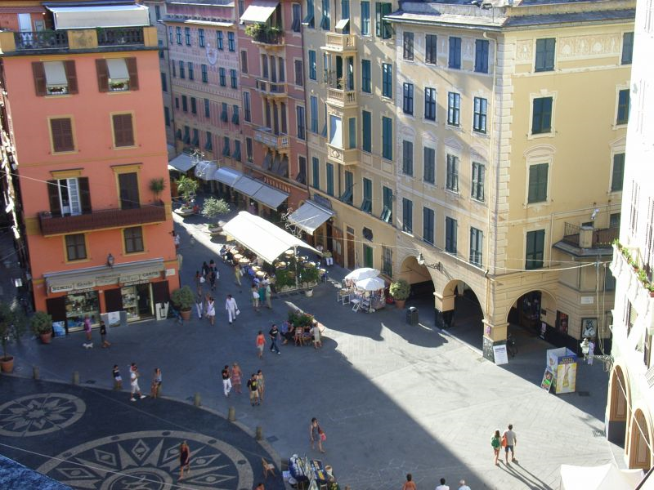
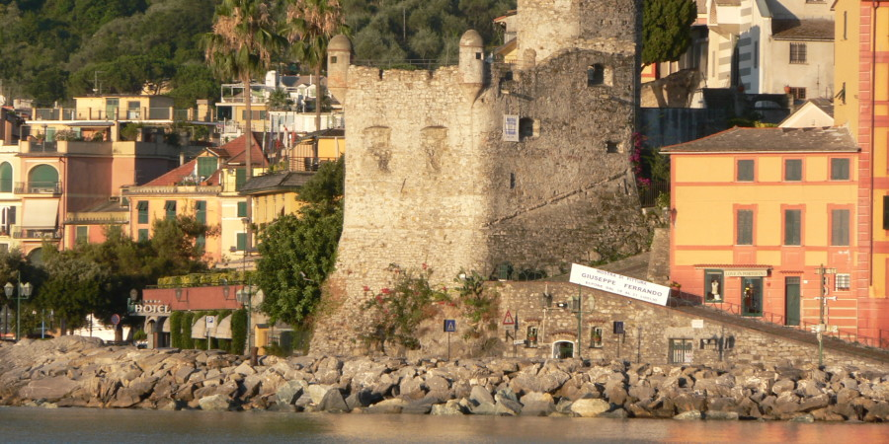
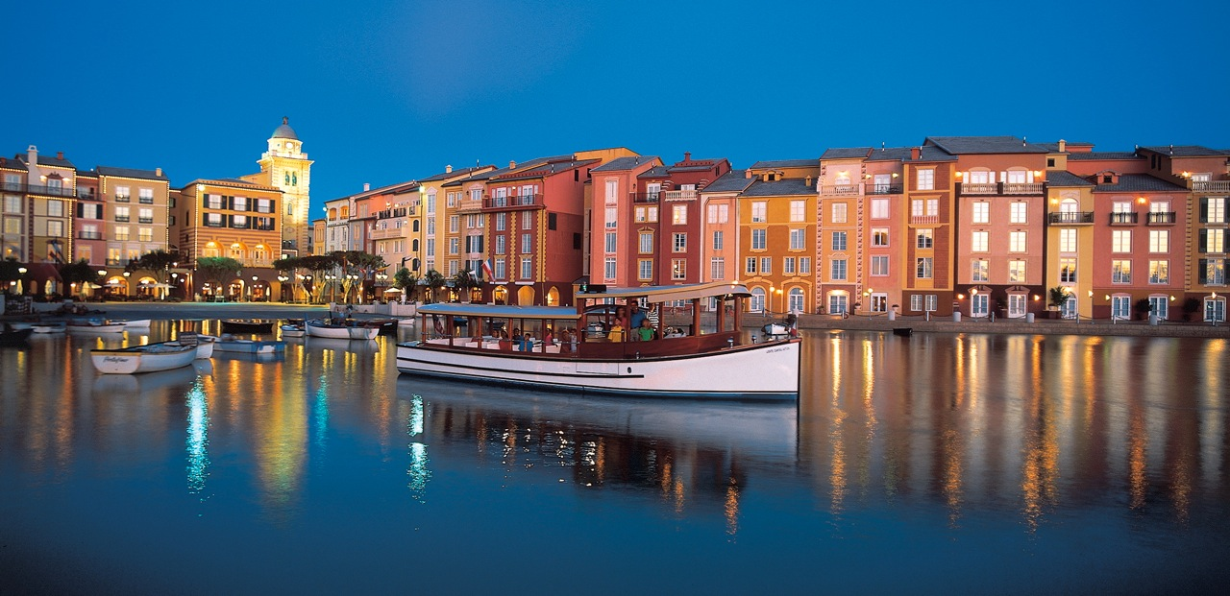
…and a trip to surprise….

Slide 12
…now we only miss you…..
We’re waiting….Save the date and prepare the smile!!!

